Slide 1
Image Classifier with Flickr API Data
Tchuissi Mbu Nyamsi, Jorge Neyra and Barker French

Slide 2
Problem Statement & Project Description
Problem statement:
Using tagged images from Flickr, create labeled training-data to train a machine learning model that will take an image and return a written description of the image.
Description:
Using Python, get image data in sets of 500 from Flickr, save image data with english language descriptions.
Convert image data to Spark DataFrame and Upload to MongoDB Atlas.
Download image data from MongoDB Atlas with Spark.
Get actual images from Flickr. Save images to Google Drive for Training.
Train Convolutional Neural Network with pre-curated Kaggle Data
Test model on images taken with phone

Slide 3
Implementation
Identified model architecture
https://arxiv.org/pdf/1502.03044.pdf
https://github.com/jorgeso/a-PyTorch-Tutorial-to-Image-Captioning
Acquired training data
https://www.kaggle.com/ming666/flicker8k-dataset
flickr api calls
Downloaded thousands of sets of Flickr image data
Processed image data selecting images data with english language descriptions
Defined data format for training model
Created MongoDB Atlas database
Saved 2,572 sets of image data to MongoDB Atlas with Spark: click for workbook
Downloaded image data from MongoDB with Spark and then downloaded actual images from Flickr and saved to Google Drive where they were staged for model training: click for workbook
Trained Model with 40,000 images from Kaggle training Data
Tested model with pictures take from our phones

Slide 4
Progress Report
Flickr API
Fetch Images and metadata, Save to MongoDB: Success
Used to train deep learning models: Success
MongoDB Repository for Image data: Success
Pyspark used for unifying storage and modeling: Success
Pyspark used for streaming and data wrangling
Data streaming from API: Implemented Alternative
Data Wrangling: Implemented Alternative
Data Wrangling
- check for english tags, process for selecting tags,convert tags to factors, decide on NLP methods to use on tags: Success
- Normalize picture pixels: Success
Modeling
Pytorch framework Success
Convolutional neural network Success
multilabel classification: Implemented Alternative
Notes:
Make sure to mention for parts that were not implement, what we actually did.
Data streaming from API
There was no need for streaming
Used native Python libraries to make API calls
Data wrangling:
We did find any NLP packages for PySpark
Used native Python libraries

Slide 5
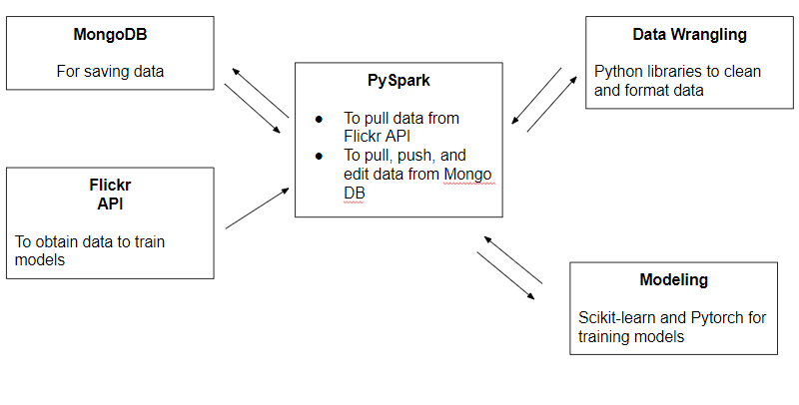
Original Technical Environment
Google Colaboratory

Slide 6
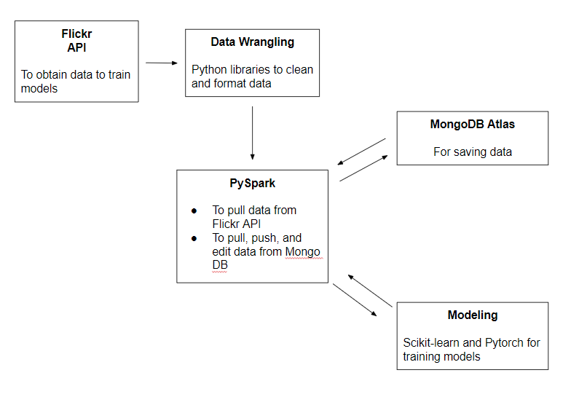
Final Technical Environment
Google Colaboratory

Slide 7
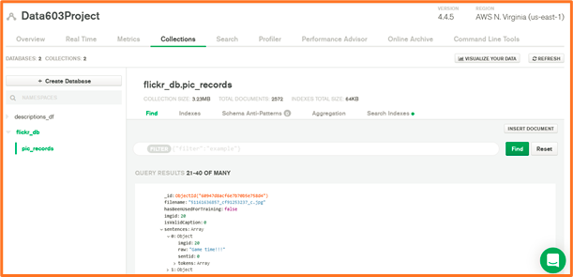
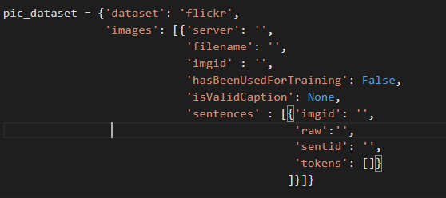
MongoDB Atlas
Image Data Format
Notes:
mention the total document number 2572 to show it is aligned with the graphs on the next page

Slide 8
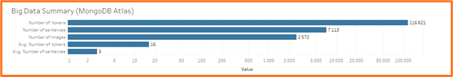
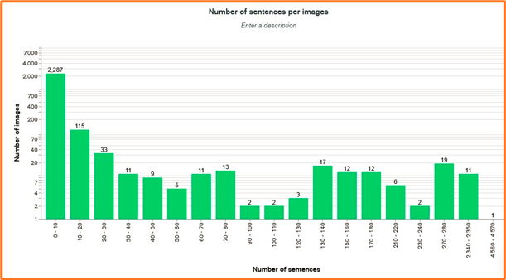
Big Data Summary
Graphs with Tableau and
MongoDB Chart
Notes:
Most of the images have less than 10 sentences (89% : 2,287/2572*10). Only a few might be actually long text
We exported json file from MongoDB with python librairies

Slide 9
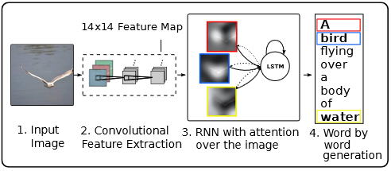
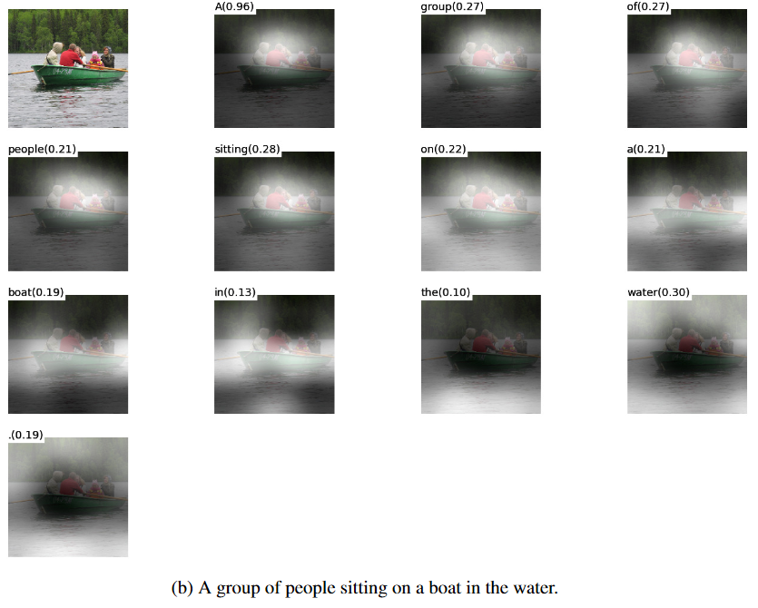
Modeling - Architecture
Show, Attend and Tell: Neural Image Caption Generation with Visual Attention
Convolutional neural network to learn features from the picture
Attention component that helps with focusing on certain areas of the picture
Long short-term memory to predict the sequence of words that describe the picture
Source: https://arxiv.org/pdf/1502.03044.pdf

Slide 10
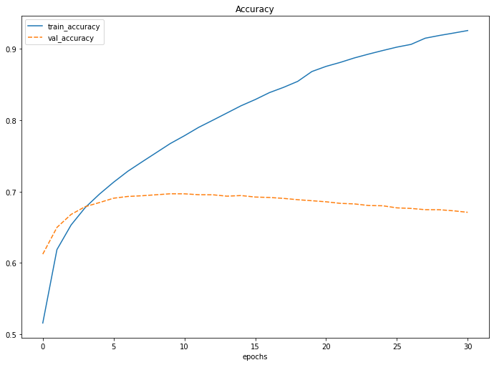
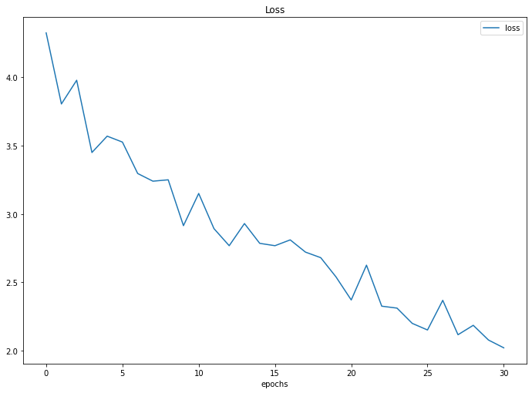
Modeling - Training
Initial training on ~8,000 images
70% train
15% test
15% validation
Training lasted around 2 hours
Idea is to continue to train model with new data from Flickr API

Slide 11
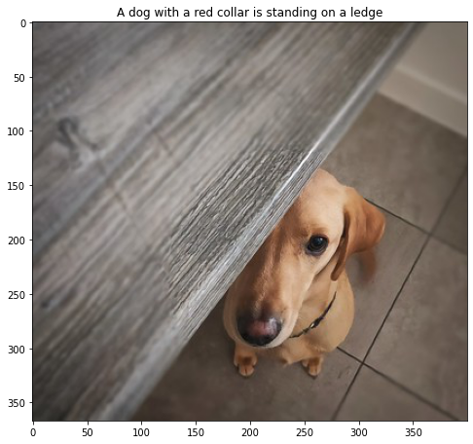
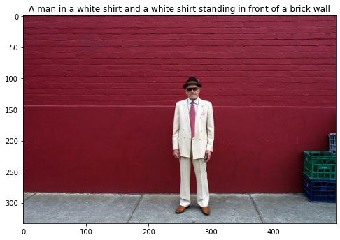
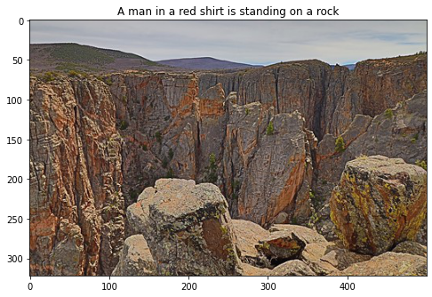
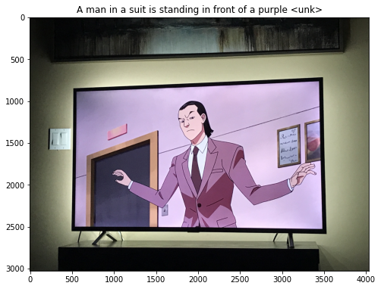
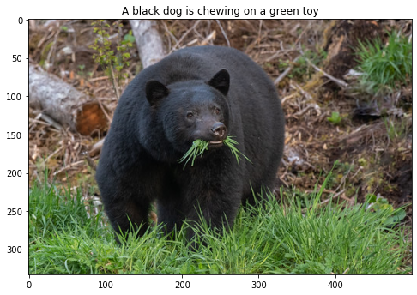
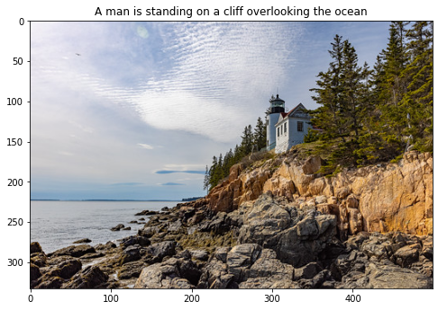
Modeling - Testing

Slide 12
Conclusion/Lessons Learned
Learned to use the following tools to create a big data pipeline:
Made calls to web API to procure data - Flickr API
Used distributed system to process and store data - PySpark
Used distributed document database as data source - MongoDB
Used neural network framework for training model - PyTorch
Applied data wrangling to transform raw data into a format that can be used to train a model
Used NLP methods
Created method for ongoing neural network model training using big data pipeline

